Slide 1
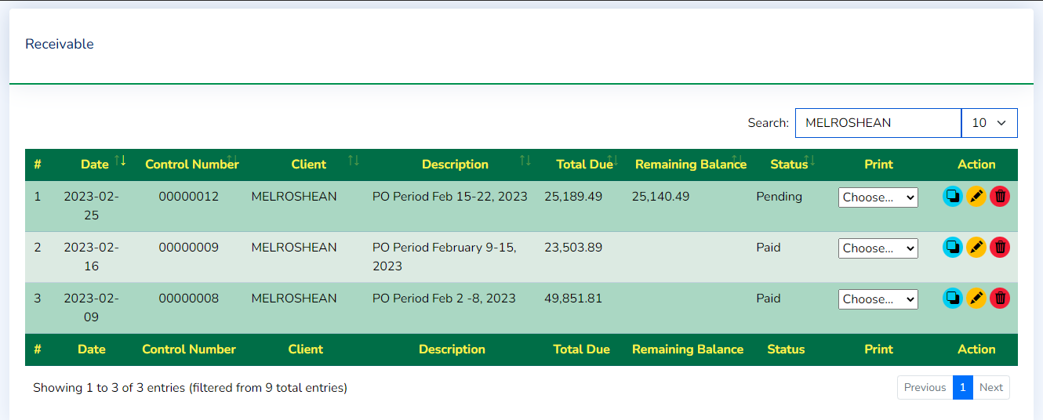
Add Payment
Remaining Balance

Slide 2
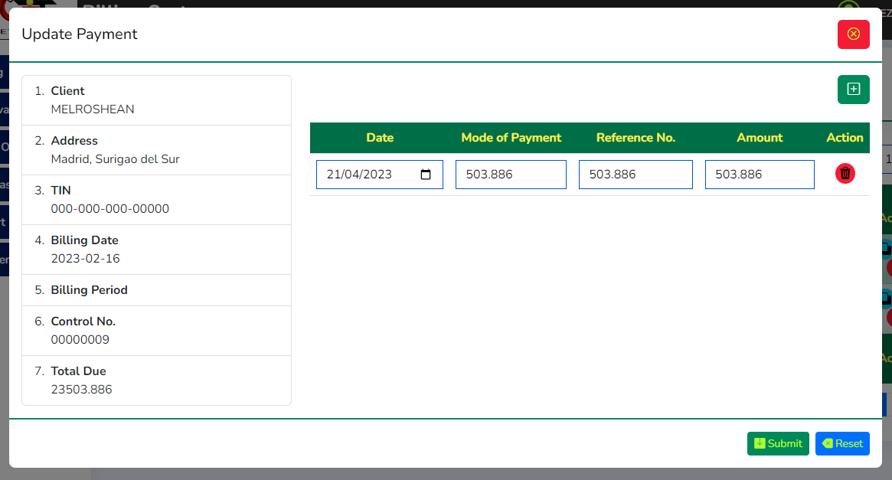
Update Payment

Slide 3

Select Item to Print
SOA – Statement of Account
Billing
Receivable

Slide 4
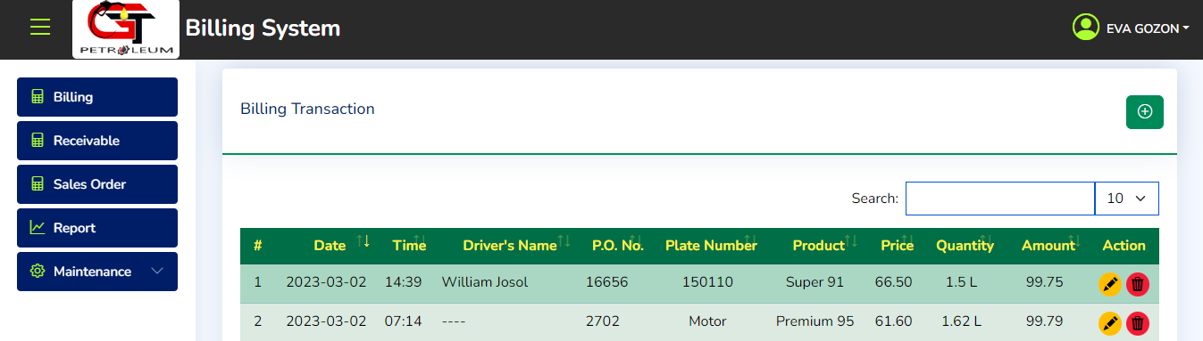
Purchase order only available to Admin

Slide 5
Purchase order only available to Admin
Interface above image is for User

Slide 6
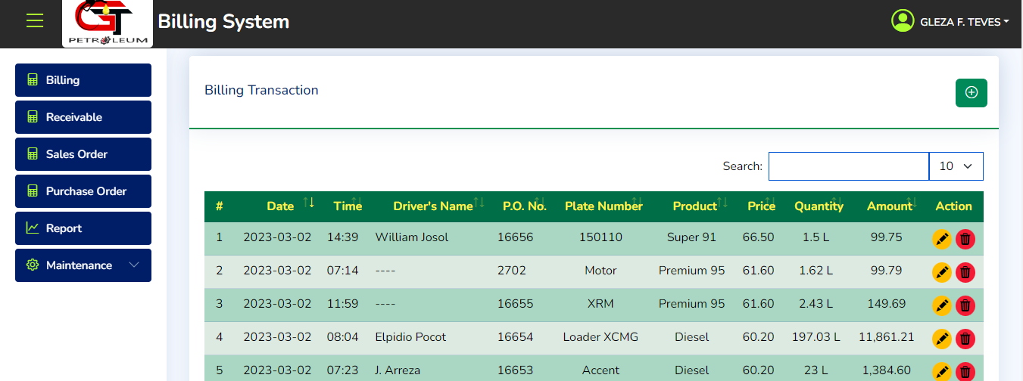
Purchase order only available to Admin
Interface above image is for Admin

Slide 7
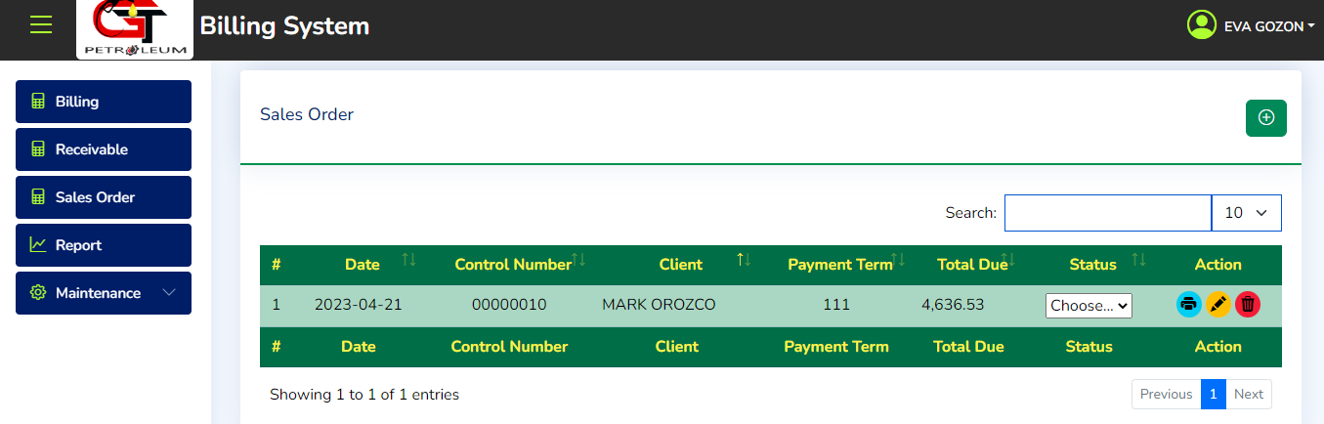
Sales order data will be hidden to user after 1 Day.
Interface above image is for User Account show only 1 row of the current date. Data will show based on encoded Date

